Slide 1


Glexy Sundesha
March 2024

Slide 2

Outline
Executive Summary
Introduction
Methodology
Results
Conclusion
Appendix

Slide 3
Executive Summary
Methodologies
Data Collection
Data Visualization
EDA with SQL
Interactive Map with Folium
Dashboards with Plotly Dash
Predictive Analysis
Summary of all results
Exploratory Data Analysis results
Interactive maps and dashboard
Predictive results

Slide 4
Introduction
Project background and context
SpaceX, a leader in the industry, aims to make space travel affordable . Its accomplishments include sending spacecraft to the international space station, launching a satellite constellation that provides internet access and sending manned missions to space. SpaceX can do this because the rocket launches are relatively inexpensive due to its reuse of the first stage of its Falcon 9 rocket. By determining if the first stage will land, we can determine the price of the launch. To do this, we can use public data and machine learning models to predict whether SpaceX .
Problems you want to find answers
Main characteristics of a successful or failed landing ?
Success or failure of a landing ?
Conditions that allow SpaceX to achieve the best landing success rate ?

Slide 5

Section 1

Slide 6
Methodology
Executive Summary
Data collection methodology:
SpaceX REST API
Web Scrapping
Perform data wrangling
Dropping unnecessary columns
Perform exploratory data analysis (EDA) using visualization and SQL
Perform interactive visual analytics using Folium and Plotly Dash
Perform predictive analysis using classification models
How to build, tune, evaluate classification models

Slide 7
Data Collection
Request data- from SpaceX API (rocket launch data)
Decode response- using .json() and convert to a dataframe using .json_normalize()
Request information- about the launches from SpaceX API using custom functions
Create dictionary- from the data
Create dataframe- from the dictionary
Filter dataframe- to contain only Falcon 9 launches
Replace missing values- of Payload Mass with calculated .mean()
Export data- to csv file

Slide 8
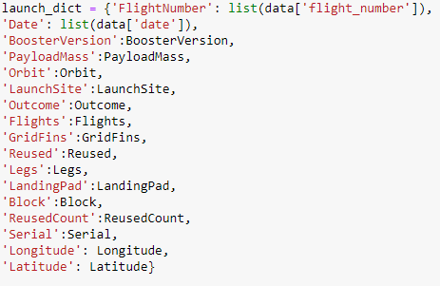
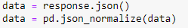
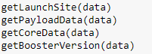
Data Collection – SpaceX API
1. Getting Response from API
2. Convert Response to JSON File
3. Transform data
4. Create dictionary with data
5. Create dataframe
6. Filter dataframe
7. Export to file
https://github.com/GlexyMS/GLEXY--CAPSTONE-FALCON-9-PROJECT/blob/main/jupyter-labs-spacex-data-collection-api(2).ipynb

Slide 9
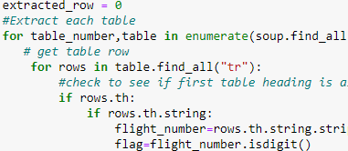
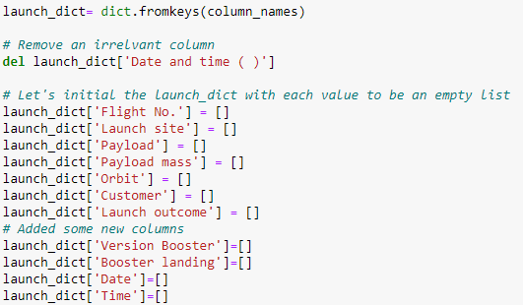
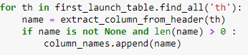
Data Collection - Scraping
1. Getting Response from HTML
2. Create BeautifulSoup Object
3. Find all tables
4. Get column names
5. Create dictionary
6. Add data to keys
7. Create dataframe from dictionary
8. Export to file
https://github.com/GlexyMS/GLEXY--CAPSTONE-FALCON-9-PROJECT/blob/main/jupyter-labs-webscraping.ipynb

Slide 10
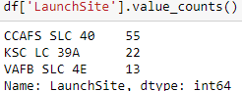
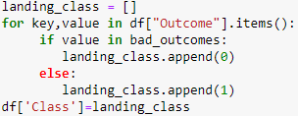
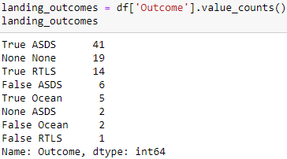
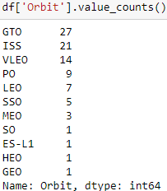
Data Wrangling
In the dataset, there are several cases where the booster did not land successully.
We need to transform variables into categorical variables where 1 means success and 0 means failure.
1. Calculate launches number for each site
2. Calculate the number and occurence of each orbit
3. Calculate number and occurrence of mission outcome per orbit type
4. Create landing outcome label from Outcome column
5. Export to file
https://github.com/GlexyMS/GLEXY--CAPSTONE-FALCON-9-PROJECT/blob/main/labs-jupyter-spacex-Data%20wrangling.ipynb

Slide 11
EDA with Data Visualization
Scatter Graphs
Flight Number vs. Payload Mass
Flight Number vs. Launch Site
Payload vs. Launch Site
Orbit vs. Flight Number
Payload vs. Orbit Type
Orbit vs. Payload Mass
Bar Graph
Success rate vs. Orbit
Line Graph
Success rate vs. Year
https://github.com/GlexyMS/GLEXY--CAPSTONE-FALCON-9-PROJECT/blob/main/jupyter-labs-eda-dataviz.ipynb.jupyterlite.ipynb

Slide 12
EDA with SQL
We performed SQL queries
Displaying the names of the unique lauunch sites in the space mission.
Display 5 records where launch sites begin with the string 'CCA'
Display the total payload mass carried by boosters launched by NASA (CRS).
Display average payload mass carried by booster version F9 v1.1.
List the date when the first successful landing outcome in ground pad was achieved.
List the names of the boosters which have success in drone ship and have payload mass greater than 4000 but less than 6000.
List the total number of successful and failure mission outcomes.
List the names of the booster_versions which have carried the maximum payload mass.
List the records which will display the month names, faiilure landing_ouutcomes in drone ship, booster versions, launch_site for the months in year 2015.
Rank the count of landing outcomes (such as Failure (drone ship) or Success (ground pad)) between the date 2010-06-04 and 2017-03-20, in descending order.
https://github.com/GlexyMS/GLEXY--CAPSTONE-FALCON-9-PROJECT/blob/main/jupyter-labs-eda-sql-coursera_sqllite(2).ipynb

Slide 13
Build an Interactive Map with Folium
Folium map object is a map centered on NASA Johnson Space Center at Houson, Texas
Red circle at NASA Johnson Space Center's coordinate with label showing its name
Red circles at each launch site coordinates with label showing launch site name The grouping of points in a cluster to display multiple and different information for the same coordinates
Markers to show successful and unsuccessful landings. Green for successful landing and Red for unsuccessful landing.
Markers to show distance between launch site to key locations
We understand the problem and the data. We can easily display all launch sites, the surroundings and successful and unsuccessful landings.
https://github.com/GlexyMS/GLEXY--CAPSTONE-FALCON-9-PROJECT/blob/main/lab_jupyter_launch_site_location.jupyterlite%20(3).ipynb

Slide 14
Build a Dashboard with Plotly Dash
Dashboard has dropdown, pie chart, rangeslider and scatter plot components
Dropdown allows a user to choose the launch site or all launch sites
Pie chart shows the total success and the total failure for the launch site chosen with the dropdown component Rangeslider allows a user to select a payload mass in a fixed range
Scatter chart shows the relationship between two variables, in particular Success vs Payload Mass
14
https://github.com/GlexyMS/GLEXY--CAPSTONE-FALCON-9-PROJECT/blob/main/plotly

Slide 15
Predictive Analysis (Classification)
Data preparation
Load dataset
Normalize data
Split data into training and test sets.
Model preparation
Selection of machine learning algorithms
Set parameters for each algorithm to GridSearchCV
Training GridSearchModel models with training dataset
Model evaluation
Get best hyperparameters for each type of model
Compute accuracy for each model with test dataset
Plot Confusion Matrix
Model comparison
Comparison of models according to their accuracy
The model with the best accuracy will be chosen (see Notebook for result)
https://github.com/GlexyMS/GLEXY--CAPSTONE-FALCON-9-PROJECT/blob/main/SpaceX_Machine_Learning_Prediction_Part_5.jupyterlite%20(1).ipynb

Slide 16
Results
Exploratory data analysis results
Interactive analytics demo in screenshots
Predictive analysis results

Slide 17

Section 2

Slide 18
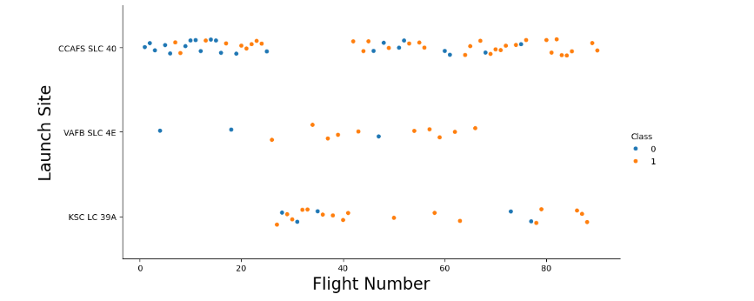
Flight Number vs. Launch Site
For each site, the success rate is increasing.

Slide 19
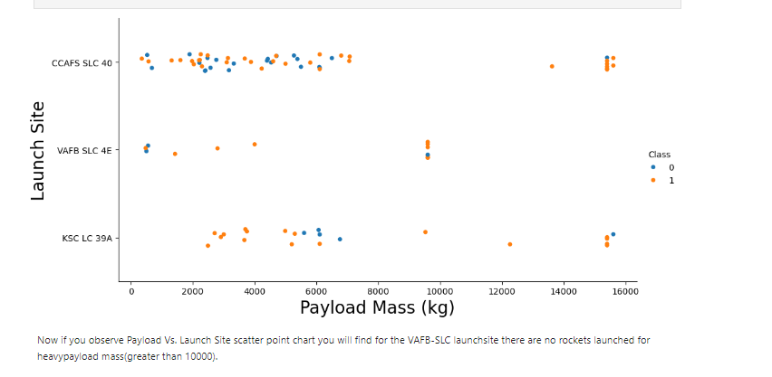
Payload vs. Launch Site

Slide 20
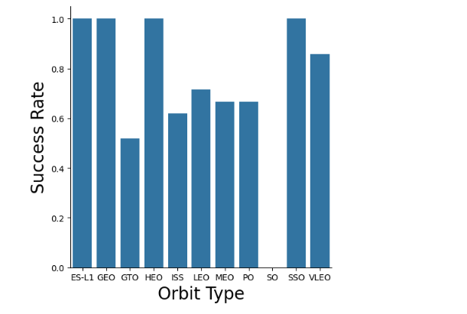
Success Rate vs. Orbit Type
We note that ES-L1, GEO, HEO, SSO have the best success rate.

Slide 21
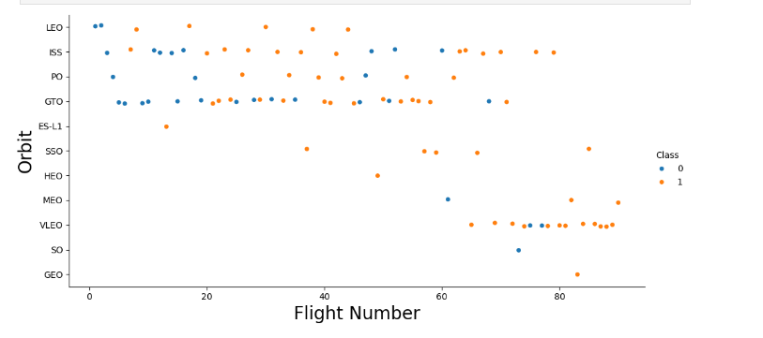
Flight Number vs. Orbit Type
The success rate increases with the number of flights for the LEO orbit. For some orbits like GTO, there is no relation between the success rate and the number of flights.

Slide 22
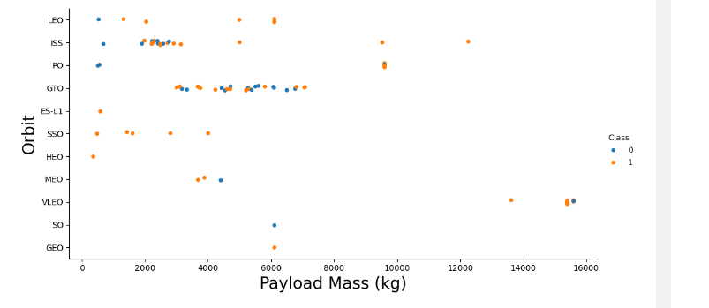
Payload vs. Orbit Type
The weight of the payloads influence the success rate of the launches in certain orbits. For example, heavier payloads improve the success rate for the LEO orbit.

Slide 23
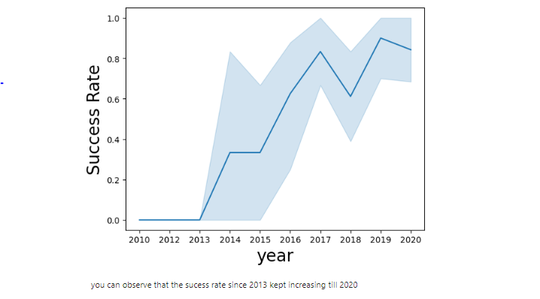
Launch Success Yearly Trend

Slide 24
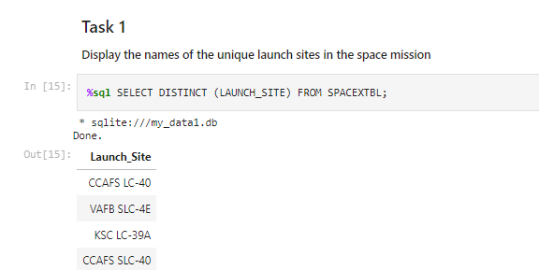
All Launch Site Names
Launch_Site
CCAFS LC-40
VAFB SLC-4E
KSC LC-39A
CCAFS SLC-40

Slide 25
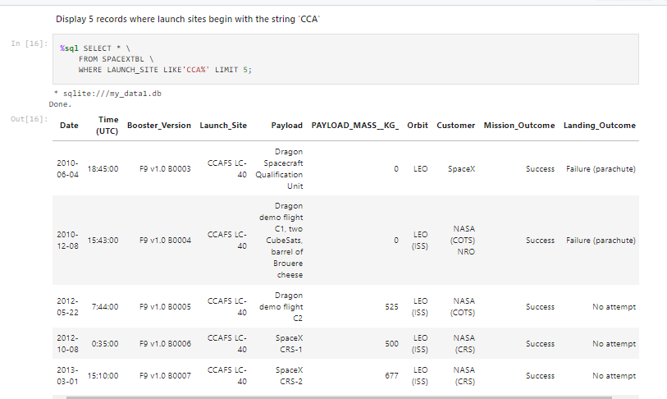
Launch Site Names Begin with 'CCA'

Slide 26
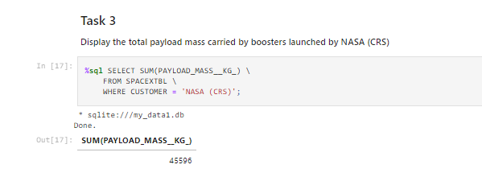
Total Payload Mass
SUM(PAYLOAD_MASS__KG_)
45596

Slide 27
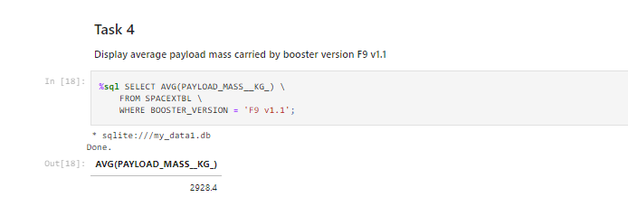
Average Payload Mass by F9 v1.1
AVG(PAYLOAD_MASS__KG_)
2928.4
This query returns the average of all payload masses where the booster version contains the substring F9 v1.1.

Slide 28
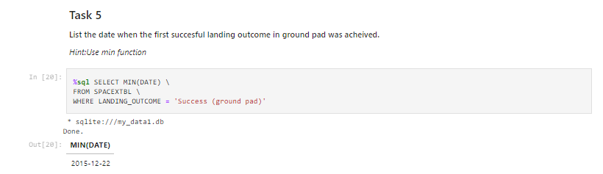
First Successful Ground Landing Date
MIN(DATE)
2015-12-22
We select the oldest successful landing.
WHERE clause filters dataset to keep only records where landing was successful. MIN function to select the oldest date

Slide 29
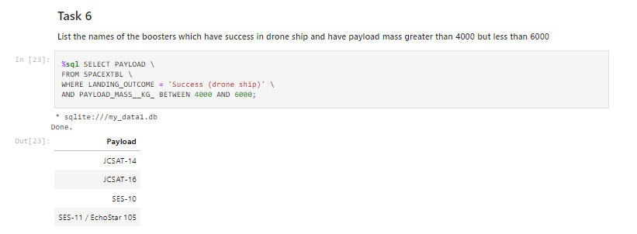
Successful Drone Ship Landing with Payload between 4000 and 6000
Payload
JCSAT-14
JCSAT-16
SES-10
SES-11 / EchoStar 105
The booster version where landing was successful oad mass is between 4000 and 6000 kg. The WHERE and AND filter the dataset.

Slide 30
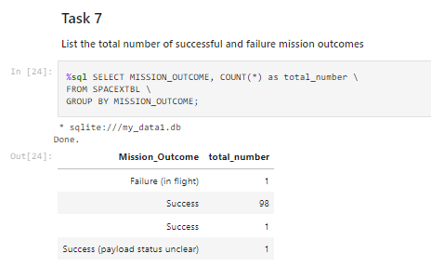
Total Number of Successful and Failure Mission Outcomes
Mission_Outcome | total_number
Failure (in flight) | 1
Success | 98
Success | 1
Success (payload status unclear) | 1
With SELECT, we show the subqueries. The first subquery counts the successful mission. The second subquery counts the unsuccessful mission. The WHERE and LIKE clause filters mission outcome. The COUNT function counts records filtered.

Slide 31
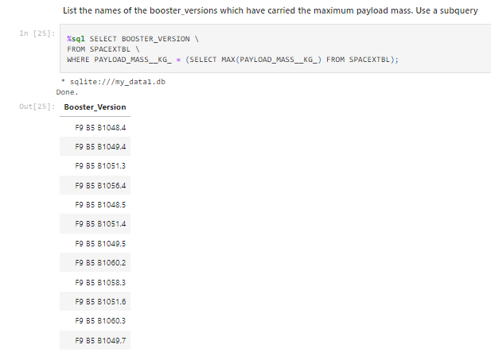
Boosters Carried Maximum Payload
Booster_Version
F9 B5 B1048.4
F9 B5 B1049.4
F9 B5 B1051.3
F9 B5 B1056.4
F9 B5 B1048.5
F9 B5 B1051.4
F9 B5 B1049.5
F9 B5 B1060.2
F9 B5 B1058.3
F9 B5 B1051.6
F9 B5 B1060.3
F9 B5 B1049.7
Filter data by returning only the heaviest payload mass with MAX function. The main query uses subquery results and returns unique booster version (SELECT DISTINCT) with the heaviest payload mass

Slide 32
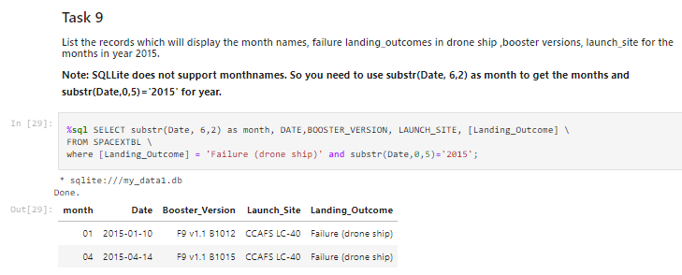
2015 Launch Records
month | Date | Booster_Version | Launch_Site | Landing_Outcome
01 | 2015-01-10 | F9 v1.1 B1012 | CCAFS LC-40 | Failure (drone ship)
04 | 2015-04-14 | F9 v1.1 B1015 | CCAFS LC-40 | Failure (drone ship)
Substr to take month or year. Substr(DATE, 6, 2) shows month. Substr(DATE,0, 5) shows year.

Slide 33
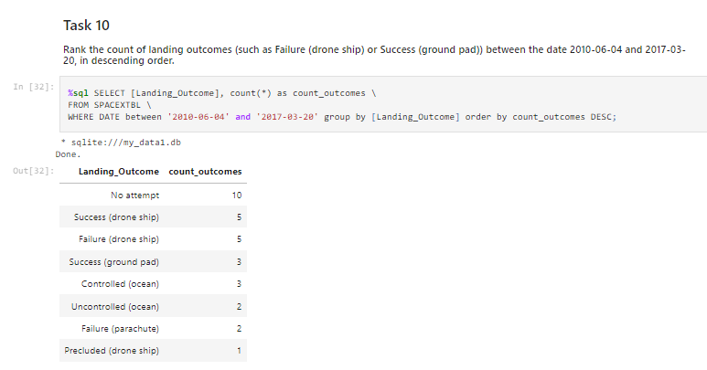
Rank Landing Outcomes Between 2010-06-04 and 2017-03-20
Landing_Outcome | count_outcomes
No attempt | 10
Success (drone ship) | 5
Failure (drone ship) | 5
Success (ground pad) | 3
Controlled (ocean) | 3
Uncontrolled (ocean) | 2
Failure (parachute) | 2
Precluded (drone ship) | 1
Landing outcome and count between 2010-06-04 and 2017-03-20. The GROUP BY clause groups results by landing outcome and ORDER BY COUNT DESC demonstrates results in decreasing
order.

Slide 34

Section 3

Slide 35
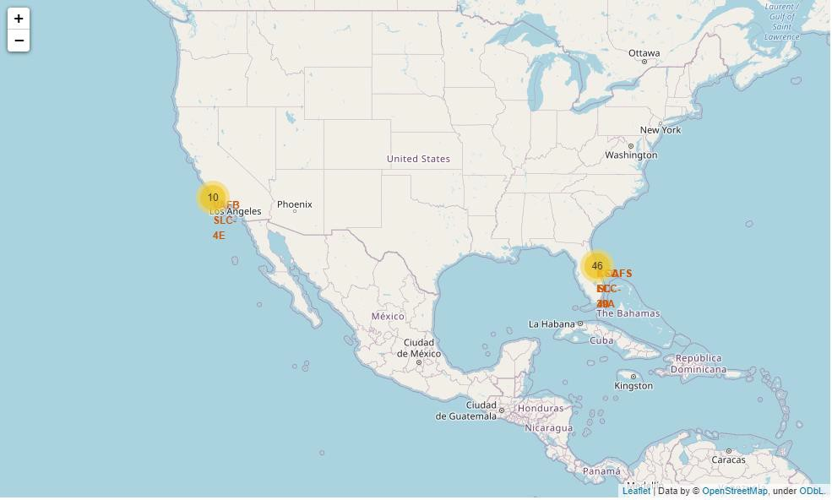
Folium map

Slide 36
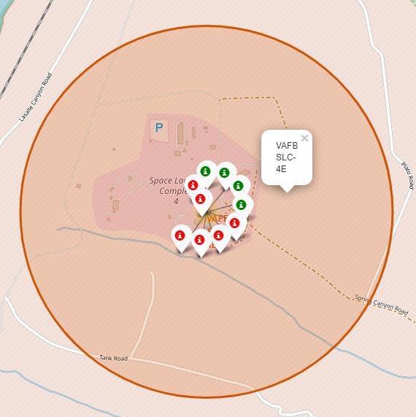
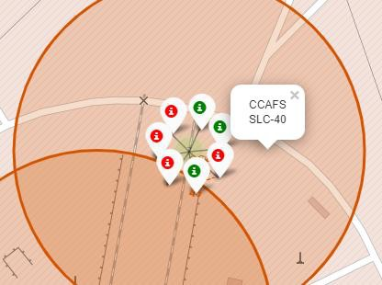
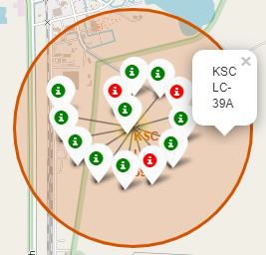
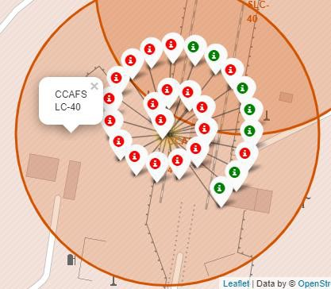
Folium map – Color Labeled Markers

Slide 37
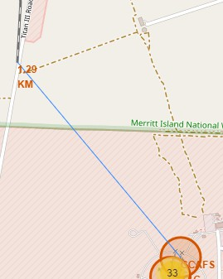
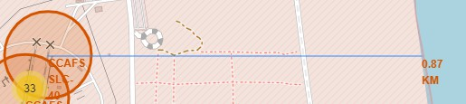
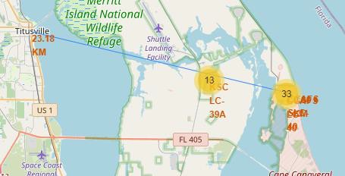
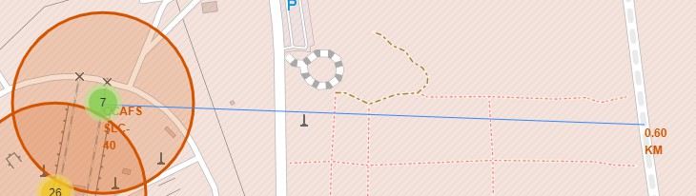
Folium Map – Proximities
Replace <Folium map screenshot 3> title with an appropriate title
Explore the generated folium map and show the screenshot of a selected launch site to its proximities such as railway, highway, coastline, with distance calculated and displayed
Explain the important elements and findings on the screenshot
Launchsite in close proximity to railways ? Yes Is Launchsite in close proximity to highways ? Yes Is in Launchsite in close proximity to coastline ? Yes
Launchsite keeps certain distance away from cities ? No

Slide 38

Section 4

Slide 39
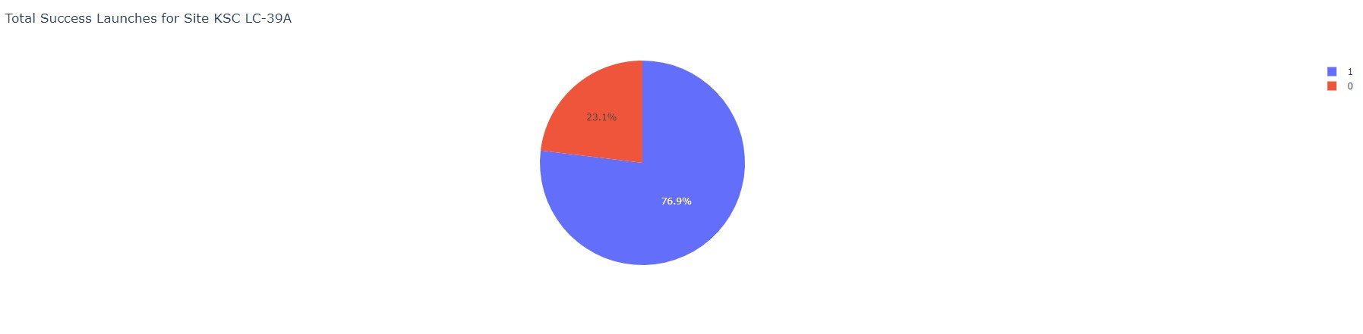
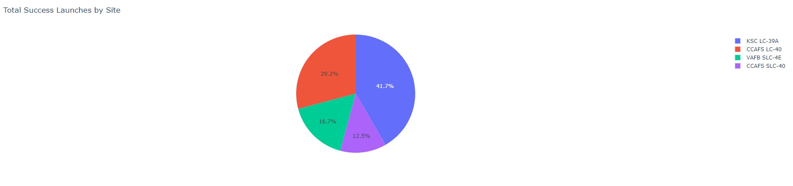
Dashboard

Slide 40
Dashboard – Success launches
Replace <Dashboard screenshot 2> title with an appropriate title
Show the screenshot of the piechart for the launch site with highest launch success ratio
Explain the important elements and findings on the screenshot

Slide 41
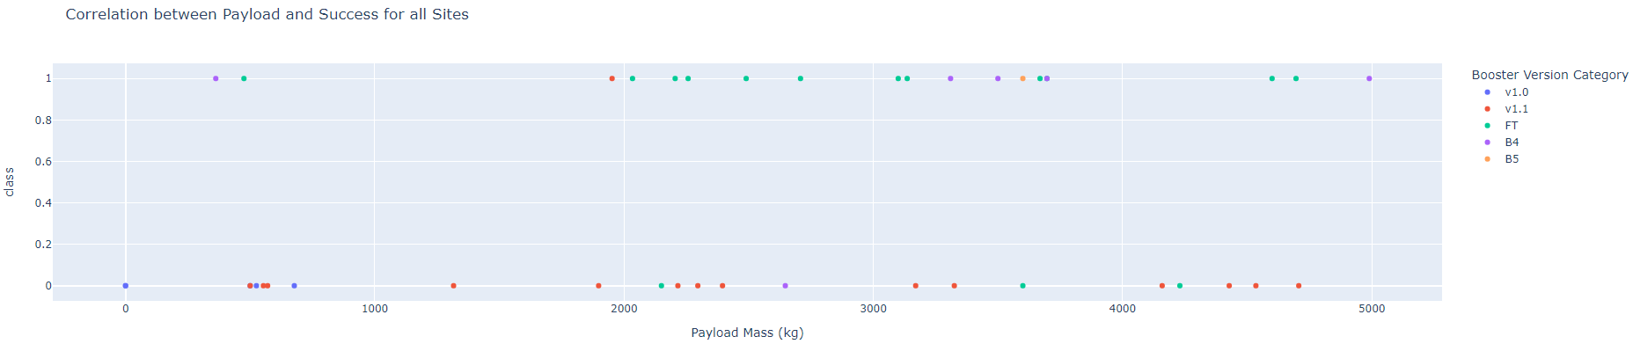
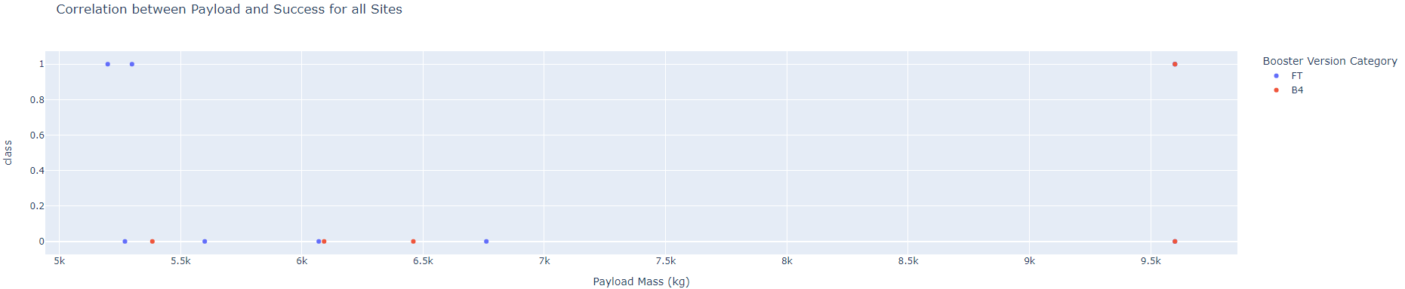
Dashboard – Payload mass vs Outcome

Slide 42

Section 5

Slide 43
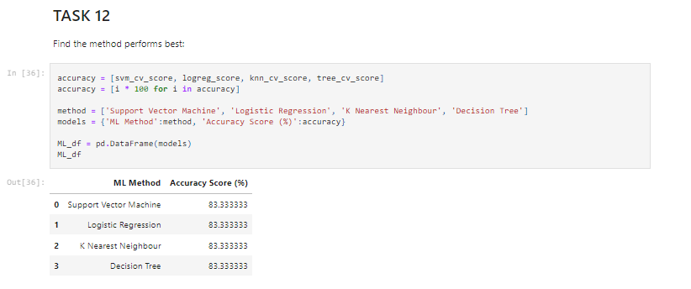
Classification Accuracy

Slide 44
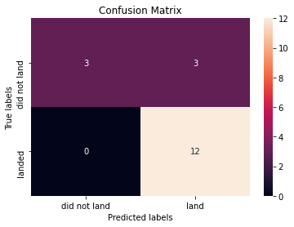
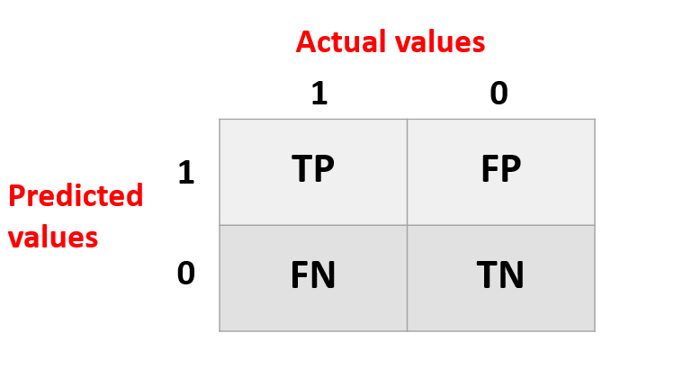
Confusion Matrix
As the test accuracy are all equal, the confusion matrices are also identical.

Slide 45
Conclusions
Model Performance: Similar performance on the test set
Equator: Most of the launch sites are near the equator for an additional natural boost
Coast: All the launch sites are close to the coast
Launch Success: Increases over time
KSC LC-39A: Has the highest success rate among launch sites. Has a 100% success rate for launches less than 5,500 kg
Orbits: ES-L1, GEO, HEO, and SSO have a 100% success rate
Payload Mass: Across all launch sites, the higher the payload mass (kg), the higher the success rate

Slide 46


